Slide 1
Networking Project
Comprehensive network design of TTEC company with two floors or more in future.

Slide 2
Contents of this presentation
Introduction | Just a quick introduction about the project.
Project Description | Description of the project and what it can do.
Project Overview | Explaining the project.
Conclusion | Description of the problems that the project overcame.

Slide 3
Introduction
In a rapidly growing organization, expansion often brings new challenges. One such challenge is designing a robust and scalable network for a new building housing number of employees. With multiple departments spread across three floors, a seamless and secure network infrastructure is essential to support daily operations. This project focuses on implementing a future-proof network solution using a hierarchical model, ensuring redundancy, security, and scalability. Leveraging technologies like VLANs, OSPF, and DHCP, the design aims to meet current needs while allowing for future growth.

Slide 4
Project Description
This project involves designing and implementing a network for a new building housing 600 staff across six departments. Using a hierarchical model with redundancy at each layer, the network will ensure reliability and security. Key features include VLAN configuration, subnetting, OSPF routing, and dynamic IP addressing via DHCP. Wireless connectivity will be provided for all departments, with port security in place for sensitive areas. The network will also connect to two ISPs for high availability.

Slide 5
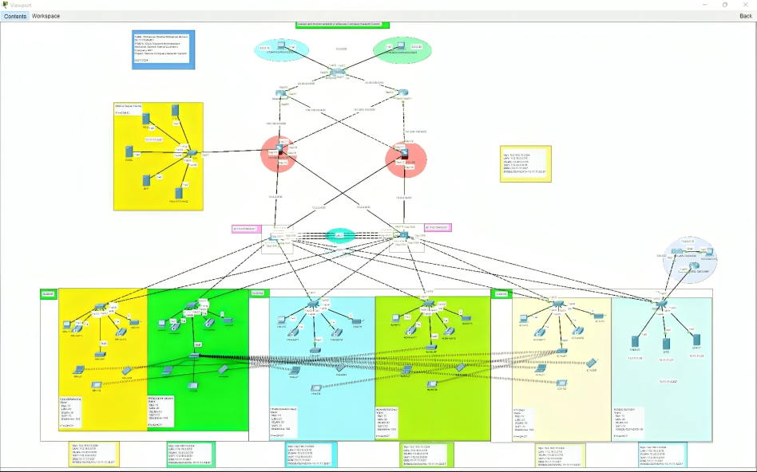
A picture is worth
a thousand words

Slide 6
Conclusion
In conclusion, this project delivers a robust, scalable, and secure network solution tailored to the organization’s needs. The design ensures redundancy, efficient data flow, and secure communication between departments. By leveraging advanced technologies like OSPF, VLANs, and DHCP, the network is prepared for both current demands and future growth. This solution will enable seamless operations and support the company’s ongoing expansion.

